Slide 1
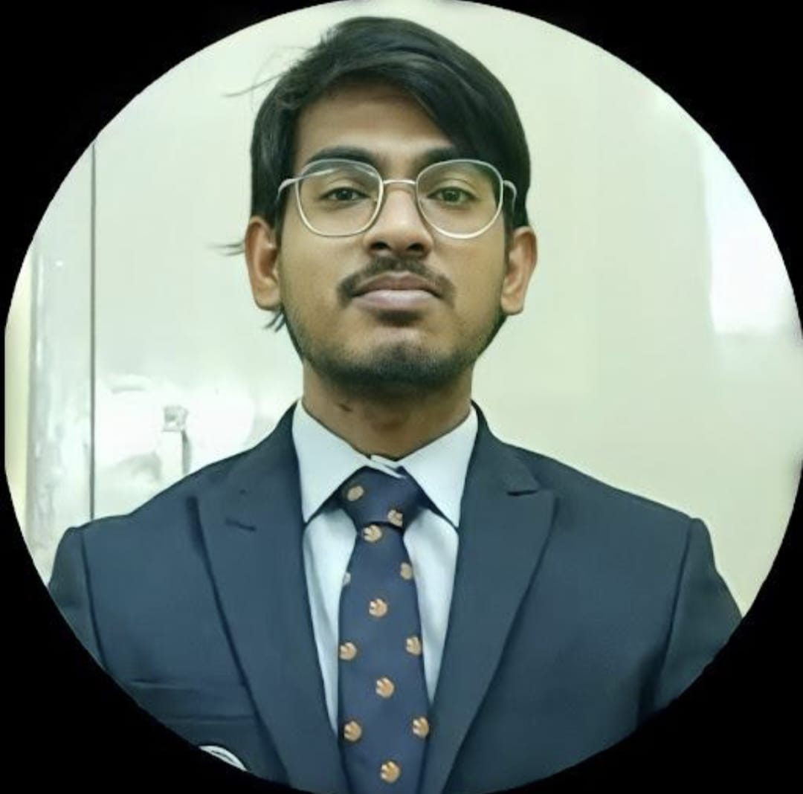
Kalyan Jyothi Swaroop
Analyst/Software Engineer
Bachelor of Technology
Computer Science Engineering :
2019- 2023
Skills
Hyderabad
Java | Java Basics, OOPs, Arrays,Loops, Collections, Generics, Java 8
Spring Core | Dependency Injection,IOC, Spring Modules, Lifecycle of bean, Autowire
Spring MVC | MVC Workflow, Implement of controllers, MVC annotations, jsp files and web xml files
Spring Rest | Rest Controller, Implementation of GET,POST,PUT,DELETE, Exception handling, Service,Presentation, Data Access Layer
Spring Boot | Spring boot starter,Swagger API
Spring Cloud | Eureka, Feign client
Database | Mongo DB-No sql(Basics)
UI Tech | ReactJs
Add on | Postman, Git & Github,Maven
Additional Skills | Good communication, Fast Learner
kalyan.a.patnala@capgemini.com
+91 7093042411
A4
Full Stack Developer
Hands on experience in creating microservices with Spring boot, Spring Cloud API Gateway, Eureka server.
Hands on experience on implementing the java concepts like oops, arrays, string, exception, collections, lambda and mongo dB basics concepts
Proficient in creating Single page Web Application in React with Authentication and Routing.
Hands on experience in developing web pages using HTML5, CSS3,Bootstrap , java Script Reactjs. Good understanding of Document Object Model (DOM) and DOM Functions.
Ready to learn new technologies and implement them for the future knowledge improvement
Course Management System
Complete both the backend & frontend development process of the case study course management application with Validations, Loggers, API Gateway in the backend and routing, binding, http request, forms with validation in frontend
Degreed
Working on the training of Core Java

